Slide 1
RECURRENT NEURAL NETWORKS (UNIT-4)
Introduction to NN and DNN
Dr. Supriya Patil

Slide 2
Sequential Data/Time Series Data
DNA sequence prediction- AGCCCCTGTGAG “AGCCCCTGTGA”
Non sequential data-
Prediction of chances of students getting or not getting placed based on input
[IQ, Marks, Gender]. Position of any parameter can be changed as there is no dependency within features and it does not affect result.
Sequential Data-
Natural language processing- My name is Geeta Here order of words can not be changed due to dependency else it will be meaningless.
Stock price prediction- Performance graph of stock for 10 years. Years will be in increasing order and you can not interchange due to dependency within them.

Slide 3
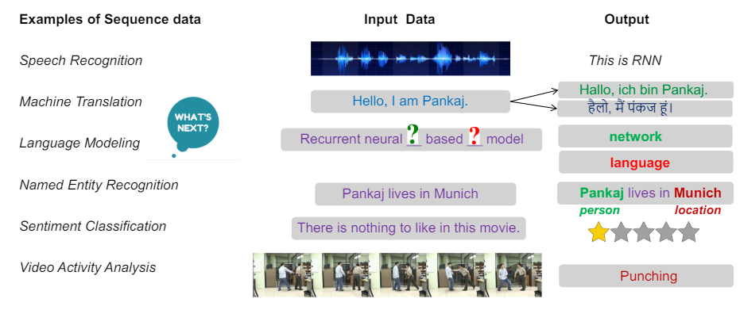
Sequential Data/Time Series Data

Slide 4
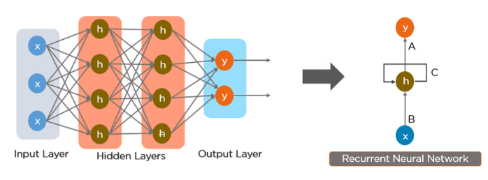
FNN Vs. RNN
RNN- Output of hidden layer is given as a input to next stage as indicated by the connection C in the diagram.
FNN

Slide 5
FNN Vs. RNN
Temporal data: Data that specifically refers to times or dates. Temporal data may refer to discrete events, such as lightning strikes; moving objects, such as trains; or repeated observations, such as counts from traffic sensors
https://www.linkedin.com/advice/3/what-difference-between-recurrent-feedforward
Feedforward neural networks | Recurrent neural networks
The data flows in one direction, from the input layer to the output layer, without any feedback loops or memory. Feedforward neural networks are good at learning static patterns and mapping fixed inputs to outputs. (I.e fixed size input vector and fixed size output vector) However, they cannot handle sequential or temporal data, such as text, speech, or video, that require some form of memory or context. Feed-forward neural networks are used in general regression and classification problems. | Recurrent neural networks are a type of neural networks that can deal with sequential or temporal data. They have a special feature that allows them to store some information from the previous inputs and outputs. This feature is called a recurrent connection, which is a loop that connects a neuron to itself or to another neuron in the same layer. Recurrent neural networks can use this connection to remember some aspects of the past data and use them to influence the current output. It can handle variable sized vector as inputs. Recurrent neural networks are good at learning dynamic patterns and capturing long-term dependencies and context.

Slide 6
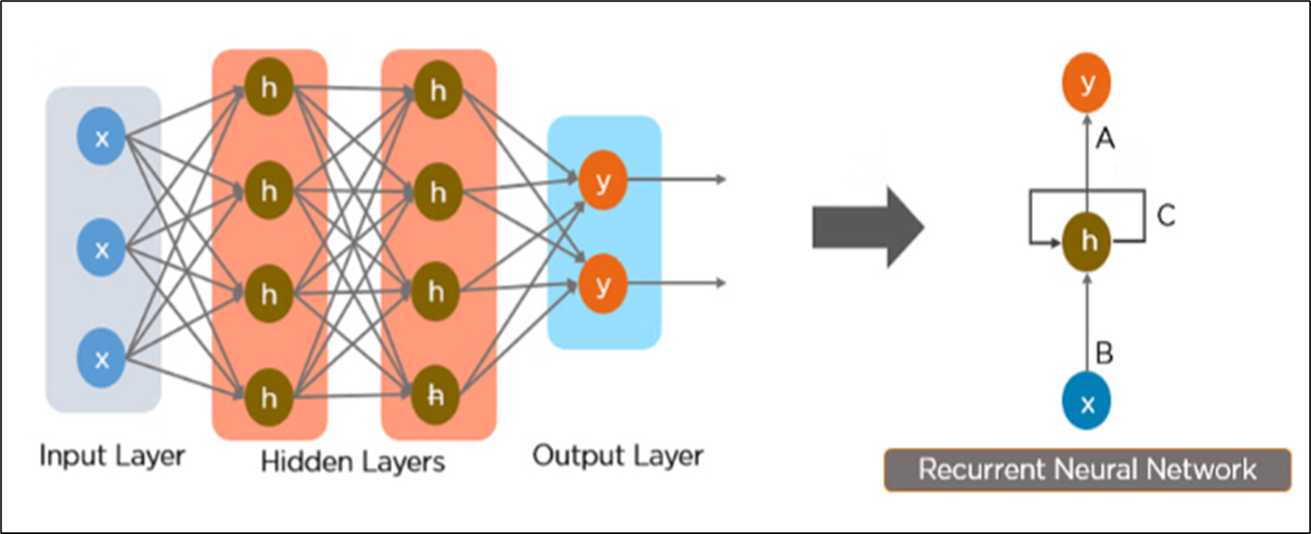
Why Recurrent Neural Networks?
RNN were created because there were a few issues in the feed-forward neural network:
Cannot handle sequential data
Cannot handle variable length data.
Considers only the current input
Cannot memorize previous inputs
The solution to these issues is the RNN. An RNN can handle sequential data, which accepts the current input data, and previously received inputs. RNNs can memorize previous inputs due to their internal memory.
Recurrent neural networks (RNNs) are a type of artificial neural network that are primarily utilized in NLP (natural language processing) and speech recognition.

Slide 7
Recurrent Neural Networks
Fixed Length: All input images of same size 28*28
All Loan approval input sample: [age, salary],
Variable Length: Different size input images 28*28, 64*64, 128*128
Few Loan approval input samples: [ age, salary]
Other Loan approval input samples: [age, salary, history]
Recurrent neural network (RNN) is a specialized neural network with feedback connection for processing sequential data or time-series data in which the output obtained is fed back into it as input along with the new input at every time step. The feedback connection allows the neural network to remember the past data when processing the next output. Such processing can be defined as a recurring process, and hence the architecture is also known as recurring neural network.
Popular RNN architectures: LSTM
GRU
Bidirectional RNN
Deep RNN

Slide 8
Simple RNN
https://link.springer.com/protocol/10.1007/978-1-0716-3195-9_4
It is a simple neural network with a feedback connection.
It has the capability to process sequential data of variable length due to the parameter sharing which generalizes the model to process sequences of variable length.
Unlike feedforward neural networks which have separate weights for each input feature, RNN shares the same weights across several time steps.
In RNN, the output of a present time step depends on the previous time steps and is obtained by the same update rule which is used to obtain the previous outputs.
The RNN can be unfolded into a deep computational graph in which the weights are shared across time steps.

Slide 9
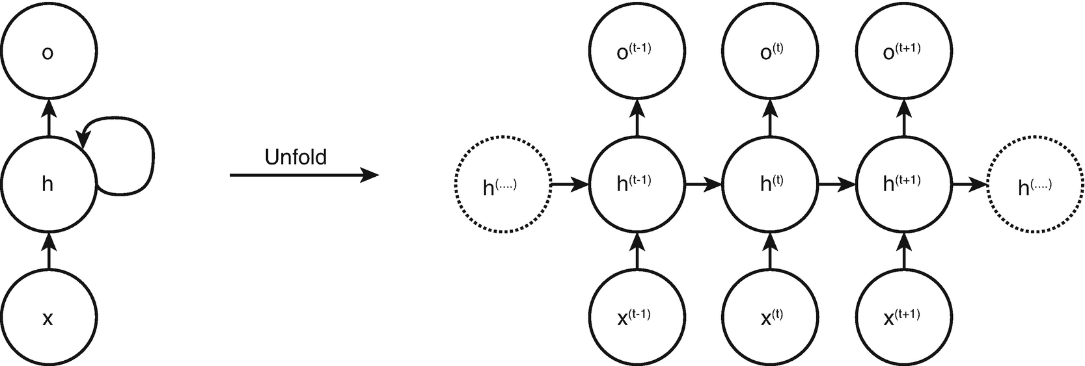
Simple RNN Architecture
The cycles in the computational graph- shows the impact of the past value of a variable on the present time step.
The computational graph has a repetitive structure that unfolds the recursive computation of the RNN.
The flow of the information is forward in the time while computing the outputs and losses are backward when computing the gradients.
V
W
U
Circuit Diagram Unfolded Computational Graph
h(t) = f(h(t−1), x(t);W), where
h is the hidden state of the network, x is the input, t is the time step, U, V , and W are the weight matrix for input-to-hidden connections, hidden-to-output connection, and hidden-to-hidden connections

Slide 10
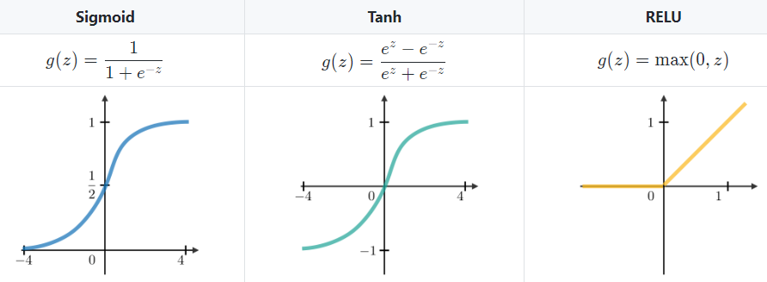
Commonly used Activation Functions

Slide 11
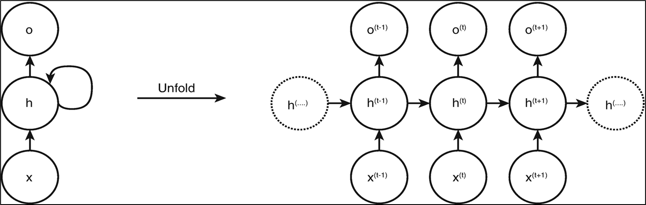
Steps for Training a Simple RNN
In the input layers, the initial input is sent with all having the same weight and activation function.
Using the current input and the previous state output, the current state is calculated.
Now the current state ht will become ht-1 for the second time step.
This keeps on repeating all the steps, and to solve any particular problem, it can go on as many times to join the information from all the previous steps.
The final step is then calculated by the current state of the final state and all other previous steps.
Now an error is generated by calculating the difference between the actual output and the output generated by our RNN model.
The final step is when the process of backpropagation occurs wherein the error is backpropagated to update the weights.

Slide 12
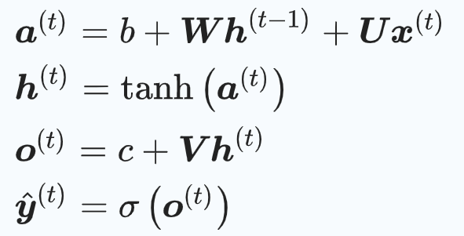
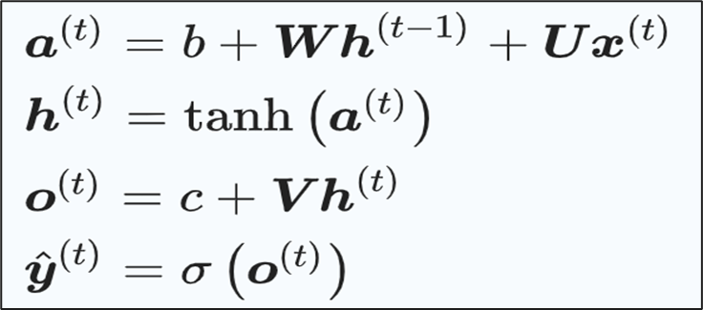
Computation in Training a Simple RNN
W
V
U
Training is performed by gradient computation of the loss function with respect to the parameters involved in forward propagation from left to right of the unrolled graph followed by back-propagation moving from right to left through the graph.
The states computed in the forward pass are stored until they are reused in the back-propagation. The back-propagation algorithm applied to RNN is known as back-propagation through time (BPTT).
The following computational operations are performed in RNN during the forward propagation to calculate the output and the loss.
Where,
b and c are the biases
a(t) is output of hidden node before applying activation function
σ is a sigmoid function, = actual output

Slide 13
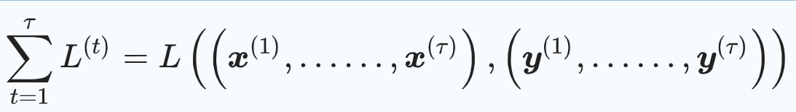
Computation in Training a Simple RNN
The total loss for a sequence of x values and its corresponding y values is obtained by summing up the losses over all time steps.
To minimize the loss, the gradient/derivative of the loss function is calculated with respect to the parameters associated with it.
The parameters associated with the nodes of the computational graph are U, V , W, b, c, x(t), h(t), o(t), and L(t). The output o(t) is the argument to the softmax to obtain the vector of probabilities over the output.
During back-propagation, the gradient for each node is calculated recursively starting with the nodes preceding the final loss.
It is then iterated backward in time to back-propagate gradients through time. tanh is a popular choice for activation function as it tends to avoid vanishing gradient problem by retaining non-zero value longer through the back-propagation process.

Slide 14
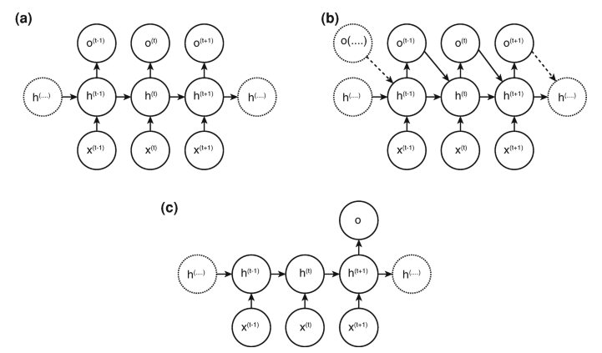
Simple RNN Architecture Variations Based on Parameter Sharing
Fig(a) - Connection between hidden units.
The RNN produces outputs at every time step, and the parameters are passed between hidden-to-hidden units
Application: Text to speech conversion- at every time stamp model will give one character or one word.
Fig(b) - Connection between outputs to hidden units.
The RNN produces outputs at every time step, and the parameters are passed from an output at a particular time step to the hidden unit at the next time step
Application: Music or text generation. Every generated word affects the next word
Fig (c)- Sequential input to single output.
The RNN produces a single output at the end after reading the entire sequence and has connections between the hidden units at every time step.
Application: Emotion detection from a sentence.

Slide 15
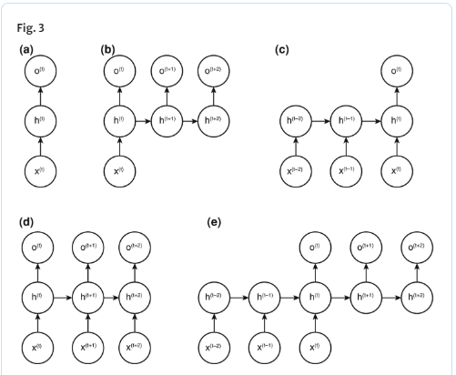
Simple RNN Architecture Variations Based on Inputs and Outputs
One-to-one: The traditional RNN has one-to-one input to output mapping at each time step t as in Fig. a. Application: Image classification- Violence/Non violence
One-to-many: It has one input at a time step for which it generates a sequence of outputs at consecutive time steps as in Fig b. Application: Image captioning.
Many-to-one: It has many inputs and one output, at each time step as in Fig. c. Application: Text classification.
Many-to-many: It can be designed in two ways.
The input is taken by the RNN and the corresponding output is given at the same time step as in Fig. d. Application: Named entity recognition.
The input is taken by the RNN at each time step and the output is given by the RNN at the next time step depending upon all the input sequence as in Fig. e. Application: Machine translation.

Slide 16
Advantages of Simple RNN
RNN can process inputs of any length.
An RNN model is modeled to remember each information throughout the time which is very helpful in any time series predictor.
The weights can be shared across the time steps.
RNN can use their internal memory for processing the arbitrary series of inputs which is not the case with feedforward neural networks.

Slide 17
Disadvantages of Simple RNN
Due to its recurrent nature, the computation is slow.
Training of RNN models can be difficult.
If we are using sigmoid or tanh as activation functions, it becomes very difficult to process sequences that are very long.

Slide 18
Disadvantages of Simple RNN
Maharashtra is a beautiful state……. The language spoken there is Marathi
https://dagshub.com/blog/rnn-lstm-bidirectional-lstm/
Problem of Long Term Dependency:
As compared to other neural network structures, RNNs are able to connect previous information to the present task, in the case of text data, using previous words to reveal the information about the present word in one complete sentence. However, unfortunately in practice, RNNs do not always do a good job in connecting the information, especially as the gap grows.
Eg: Predict the last word in “the clouds are in the sky,” any further context is not needed– Its easy to derive from the previous five words that “sky” is the next word. In such cases, where the gap between the relevant information and the place that it’s needed is small, RNNs can learn to use the past information easily.
Consider other Eg: Predict the last word in the text “I grew up in France … I speak fluent French.” Recent information suggests that the next word is probably the name of a language, but if we want to narrow down which language, we need the context of France, from further back. It’s entirely possible for the gap between the relevant information and the point where it is needed to become very large. However, RNNs generally do not do a good job of modeling within such a situation. Alternatively, we use LSTMs to solve this problem.

Slide 19
Disadvantages of Simple RNN
Thus, simple RNN works well with the short-term dependencies, but when it comes to long-term dependencies, it fails to remember the long-term information.
This problem arises due to the vanishing gradient or exploding gradient.
When the gradients are propagated over many stages, it tends to vanish most of the times or sometimes explodes.
The difficulty arises due to the exponentially smaller weight assigned to the long-term interactions compared to the short-term interactions. It takes very long time to learn the long-term dependencies.

Slide 20
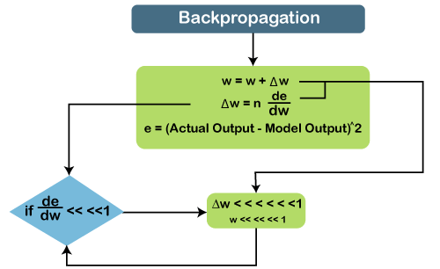
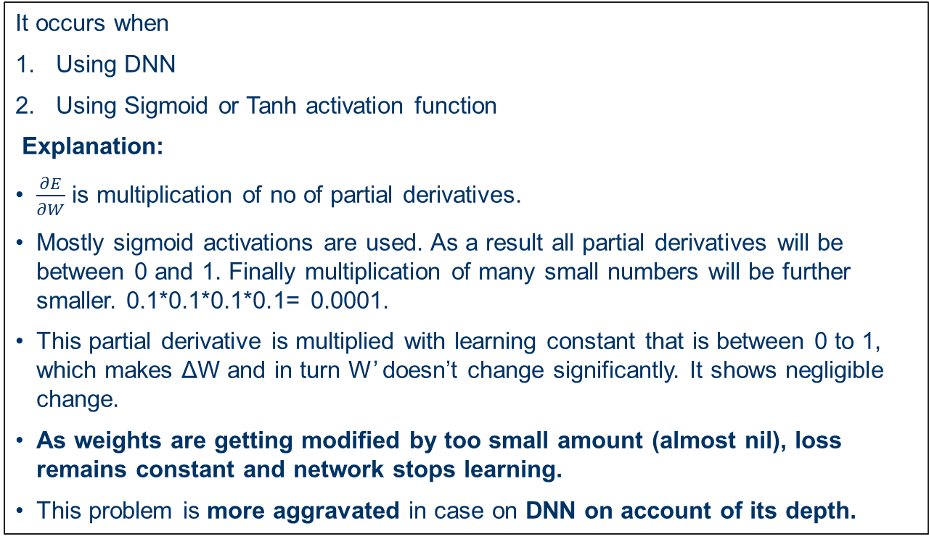
Problem of Vanishing Gradient
Best video: https://www.youtube.com/watch?v=uCrevbBh0zM
https://www.javatpoint.com/keras-recurrent-neural-networks
It occurs when
Using DNN
Using Sigmoid or Tanh activation function
Explanation:
$\frac{∂E}{∂W}$ is multiplication of no of partial derivatives.
Mostly sigmoid activations are used. As a result all partial derivatives will be between 0 and 1. Finally multiplication of many small numbers will be further smaller. 0.1*0.1*0.1*0.1= 0.0001.
This partial derivative is multiplied with learning constant that is between 0 to 1, which makes ΔW and in turn W’ doesn’t change significantly. It shows negligible change.
As weights are getting modified by too small amount (almost nil), loss remains constant and network stops learning.
This problem is more aggravated in case on DNN on account of its depth.

Slide 21
Problem of Vanishing Gradient
Basically sigmoid and Tanh activation functions squeeze the output which may be too high or low between 0 and 1. This also is a reason behind vanishing gradient problem.
How to recognise it?
Loss starts remaining constant.
Negligible change in weights with number of iterations
How to overcome it?
Reduce model complexity i.e reduce depth of network. Not a good solution as we may not be able to capture complex features.
Use ReLu activation function which brings output between eg: 0 to 1000 from -1000 to 1000 as opposed to Sigmoid between 0 to 1. As a result if output is negative, derivative will be 0 else it will be 1 Therefore, if derivatives are 1, multiplication of derivatives remains 1 and vanishing gradient problem does not occur. But in case derivative is 0, product of derivatives will be 0 and weight will not get updated.
Use proper weight initialisation techniques instead of choosing them randomly.
Use batch normalization – a network layer
Use residual network
Use LSTM, GRUs

Slide 22
Batch Normalization
Imagine you're trying to teach a student to summarize a long story. The student reads the story word by word.
RNN Without Vanishing Gradients: A good student would remember the key details from the beginning of the story to understand the ending and provide a good summary.
RNN With Vanishing Gradients: A student suffering from the vanishing gradient problem would be like a student who has a very short memory. They might remember the last few sentences, but the crucial information from the beginning of the story fades away. By the time they reach the end, they've forgotten the initial context, leading to a poor summary.
The "gradients" are like the feedback or corrections the teacher gives the student. If the student consistently makes errors early on, but the teacher's corrections (gradients) get smaller and smaller as the story progresses, the student will never properly adjust their understanding and learn to remember those early details.
How Batch Normalization helps (or tries to)- let's introduce Batch Normalization (BN) into this learning scenario:
Instead of having the student read the entire story at once, the student summarizes small parts of the story (a "batch" of words/sentences) at a time. After each part, the following occurs:
Understanding is checked and standardized: The student's comprehension of the current part is reviewed. If their understanding is inconsistent, they are guided to a more consistent comprehension for that part.
A good starting point for the next part is ensured: By normalizing the understanding of the current part, the inputs to their "memory" for the next part are more stable.

Slide 23
Batch Normalization
How this impacts vanishing gradients in RNNs
Signal strength is maintained: In RNNs, information flows between layers and across time steps (the "memory" aspect). With vanishing gradients, this information can diminish over time. Batch Normalization, by normalizing the activations (the internal values) at each time step or within each hidden layer, ensures the signal (the gradients) remains strong and relevant. It prevents values from becoming so small that the gradients vanish when backpropagated through time.

Slide 24
Batch Normalization
RNNs, the normalization is applied specifically to the activations within the recurrent part of the network at each time step.
Normalization of Inputs and Hidden States: Instead of just normalizing the inputs to the first recurrent layer, batch normalization can be applied at different points within the RNN structure, like:
  Input-to-hidden connections: Normalizing the input signal (e.g., a word embedding) as it enters
  the RNN cell.
  Hidden-to-hidden connections: Normalizing the hidden state from the previous time step before
  it's used to calculate the next hidden state. This is where it directly
  impacts the "memory" of the RNN.
  Or both: Applying BN to both the input-to-hidden and hidden-to-hidden connections for potentially
  greater impact.
Calculating Batch Statistics at Each Time Step: When applying Batch Normalization within an RNN's recurrent part, the mean and variance for normalization are calculated for each time step within the batch. According to Massed Compute, this ensures the normalization adapts to the statistics of the specific time step.

Slide 25
Residual network
Imagine teaching a student a very long, complicated dance routine.
RNN without residual connections (Traditional Learning): The student tries to memorize every single step perfectly as they go. If they struggle with a specific sequence early on, it affects everything that follows. They might even completely forget the beginning of the routine by the time they reach the end, because the earlier learning is "lost" or becomes too faint (vanishing gradient). Their performance suffers, especially for the initial parts.
RNN with residual connections (ResNets): The dance instructor changes the teaching method. Instead of just teaching each new step as a completely new movement, they introduce a simpler approach:
"Base Move" Shortcut: The instructor tells the student to always remember the basic, core dance steps (the input x). This is like a constant, strong memory of the foundation.
Learning the "Improvements": For each new, more complex part of the routine, the student is taught to focus on how it's different from the core dance steps they already know (learning the "residual function" F(x)). They don't have to re-learn the entire dance section from scratch, according to Medium. They just need to learn the subtle changes and additions needed.

Slide 26
Residual network
Combining for the Full Move: To perform the full dance, the student combines their memory of the base move with the "improvements" they just learned. This means, the final output at each step is the sum of the original input x and the learned residual F(x). So, the output is x + F(x).

Slide 27
Residual network
To resolve vanishing gradient problem residual connections can also be incorporated into RNNs that improves gradient flow.
Direct gradient flow via skip connections
Residual networks introduce skip connections that create a direct pathway for gradients to bypass one or more recurrent layers.
When backpropagating errors, these skip connections ensure that gradients can flow directly to earlier layers and time steps, even if they encounter very small gradients in the main recurrent path.
This prevents the gradients from becoming extremely small (vanishing) as they travel backward through many time steps, preserving the signal needed to update the weights of earlier layers.

Slide 28
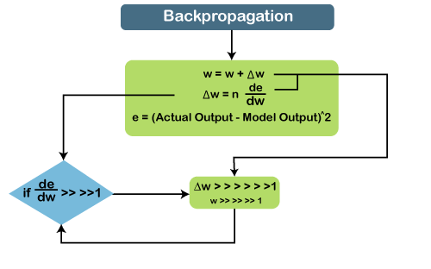
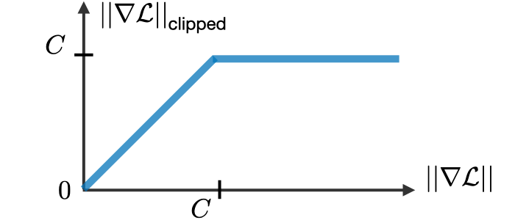
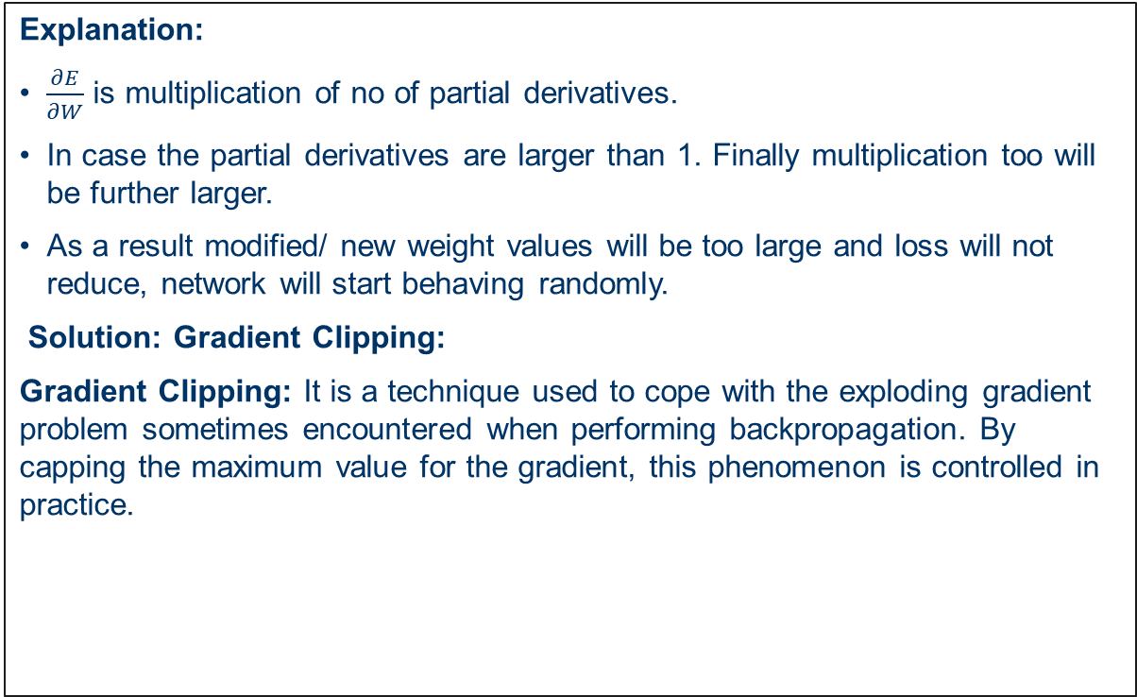
Problem of Exploding Gradient
Other solution: Use truncated BTT Backpropagation through time
Explanation:
$\frac{∂E}{∂W}$ is multiplication of no of partial derivatives.
In case the partial derivatives are larger than 1. Finally multiplication too will be further larger.
As a result modified/ new weight values will be too large and loss will not reduce, network will start behaving randomly.
Solution: Gradient Clipping:
Gradient Clipping: It is a technique used to cope with the exploding gradient problem sometimes encountered when performing backpropagation. By capping the maximum value for the gradient, this phenomenon is controlled in practice.

Slide 29
Seminar Topics
Stock price prediction using RNN …..Bhupesh
Sentiment analysis using RNN …… Glenn
Sentiment analysis using LSTM …..Aditi
Autoencoder application1 …… Aditya
Autoencoder application2 …… Risha
Application of LSTM …..Kashyap

Slide 30
Long Short Term Memory
https://www.youtube.com/watch?v=z7IPBg6MyrU&list=PLKnIA16_RmvYuZauWaPlRTC54KxSNLtNn&index=62
Long Short-Term Memory networks (LSTMs) are a special kind of RNN, capable of learning long-term dependencies.
They work tremendously well on a large variety of problems, and are now widely used.
LSTMs are explicitly designed to avoid the long-term dependency problem.
Connecting information among long periods of time is practically their default behavior.
They have a more complex cell structure than a normal recurrent neuron, that allows them to better regulate how to learn or forget efficiently from the different input sources.

Slide 31
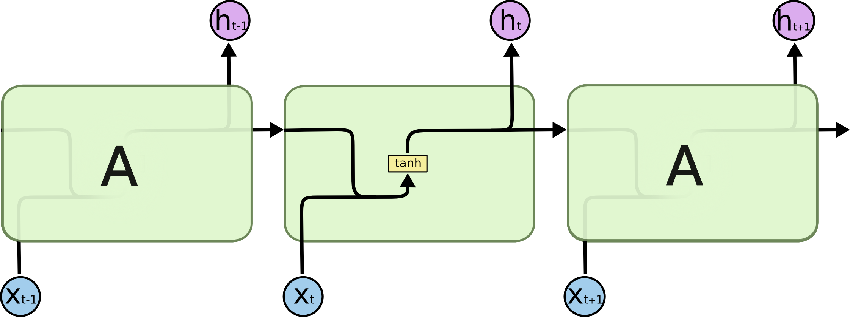
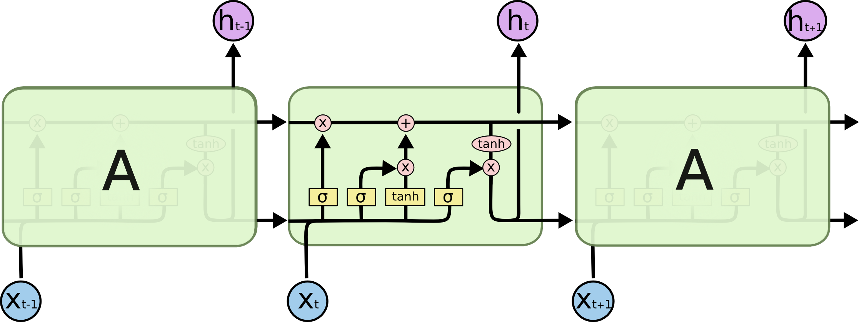
Long Short Term Memory
LTM
STM
STM
LSTM
RNN
LSTMs also have a chain-like structure, but the repeating module is a bit different complex structure. Instead of having a single neural network layer, four interacting layers are communicating extraordinarily. This four-layered structure helps LSTM retain long-term memory and can be used in several sequential problems
All RNN are in the form of a chain of repeating modules of a neural network. In standard RNNs, this repeating module will have a very simple structure, such as a single tanh layer.

Slide 32
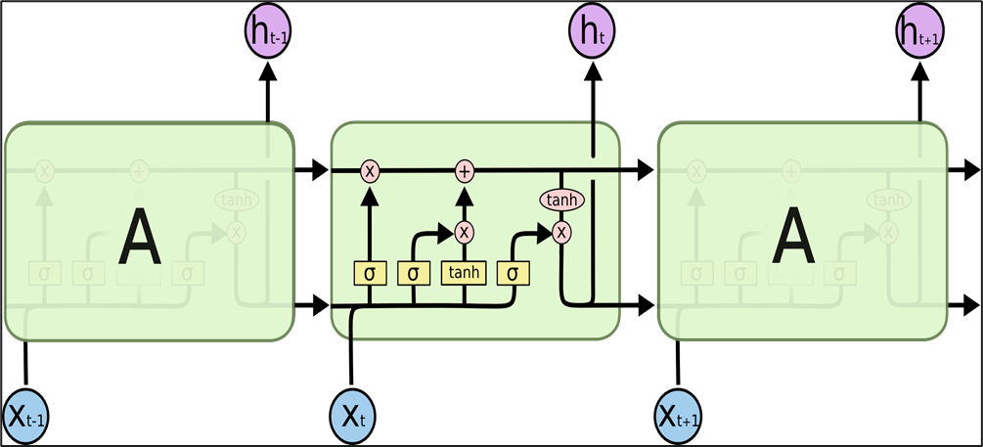
LTM
LTM
STM
STM
RNN maintains single state (short term memory), while as LSTM maintains two states (long and short term memory)
Bottom line corresponds to STM and upper one for LTM and architecture between them helps in communication between STM and LTM
LSTM has 3 inputs… LTM (Cell state), STM (Hidden state) from previous time stamp and input from current time stamp.
LSTM has 2 output… LTM and STM for next time stamp or current Cell state and Hidden state
What kind of processing is done inside? - It updates LTM and creates STM for the next stage

Slide 33
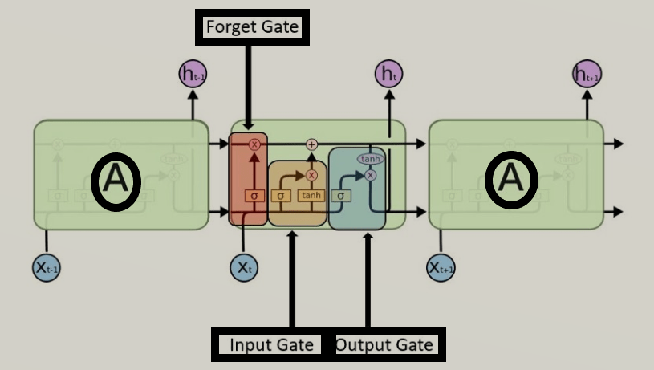
LSTM Gates
What to forget from LTM
Three gates - forget gate, input gate, output gate.
Forget Gate: Based on current input and short term context, forget gate decides what will remain in LTM. Basically which information to remove/ forget from LTM. In other words it decides what to remove from Cell state
Input gate: Based on current input it decides what to add to LTM or Cell state.
Output Gate: Based on current input what to show at the output from LTM. Its like drawing a conclusion from information in LTM. It also creates STM or Hidden state for next stage
drawing a conclusion from information in LTM
What to add to LTM

Slide 34
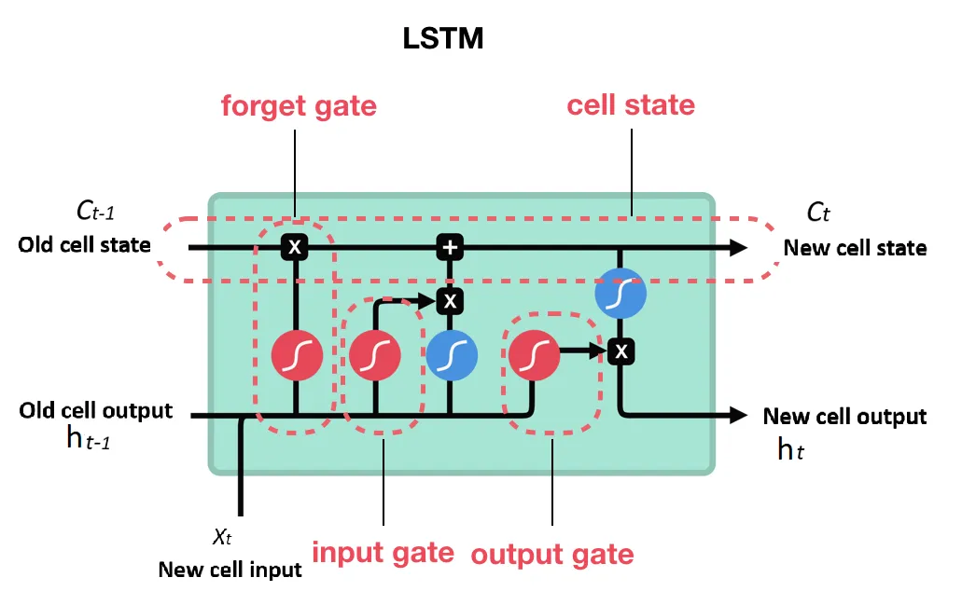
The key to LSTMs is the cell state (cell memory),
the horizontal line running through the top of the diagram,
through which the information flows along and the internal
mechanism called gates that can regulate the flow of information.
The cell state is kind of like a conveyor belt. It runs straight
down the entire chain, with only some minor linear interactions.
Cell State basically encodes the information of the inputs
(relevant info.) that have been observed up to that step (at every step).
Cell state is a memory of the LSTM cell and hidden state (cell output) is an output of this cell.
Regular RNNs have just the hidden state and no cell state. Therefore, RNNs have difficulty of accessing information from a long time ago.
https://medium.com/@humble_bee/rnn-recurrent-neural-networks-lstm-842ba7205bbf

Slide 35
LTM---- Cell State
STM---- Hidden state
ht and ct ---- vectors of same size,
xt---- vector that represents one word at a time
Ft---- vector associated with forget gate,
it, ctbar(candidate cell state)---- vector associated with input gate,
Ot---- vector associated with output gate
Ct, ht,ft, it, ctbar, ot----- vectors of same dimension
ot
it
ctbar
ft

Slide 36
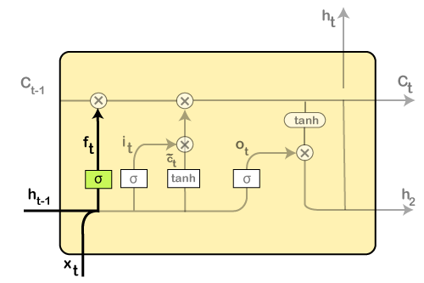
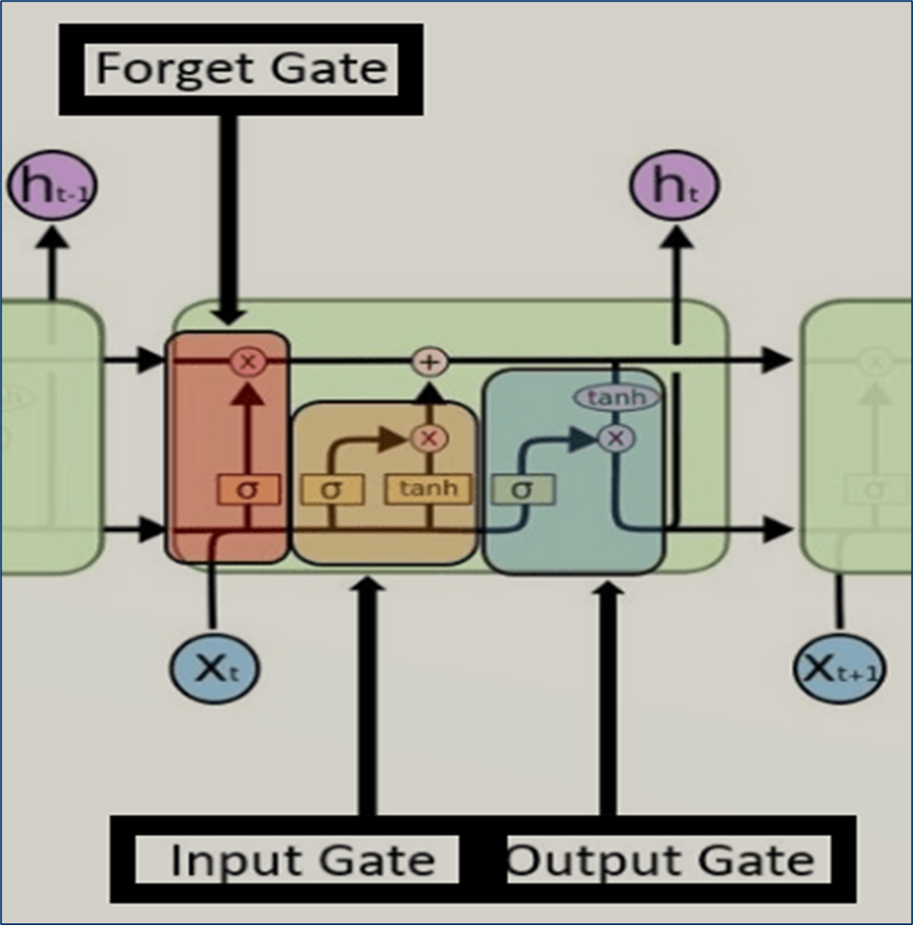
Step-by-step Approach to Understand LSTM
https://www.javatpoint.com/keras-recurrent-neural-networks
Step 1:
It identifies the information that is not required and will be thrown away from the cell state. This decision is made by a sigmoid layer, which called the forget gate layer.
The calculation is done by considering the new input, and the previous timestamp is, which eventually leads to the output of a number between 0 and 1 for each number in that cell state.
As a typical binary, 1 represents to keep the cell state while 0 represents to trash it.
ft = σ(wf [ht-1, xt] + bf)
where, wf = Weight, ht-1 = Output from previous timestamp, xt = New input, bf = Bias

Slide 37
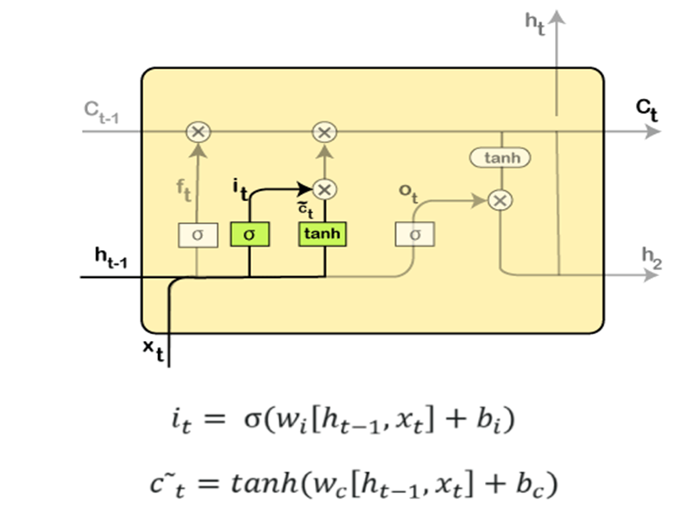
Step-by-step approach to understand LSTM
Step 2:
Next, its to be decided which information will be stored in the cell state. It further consists of the following steps:
The sigmoid layer, which is also known as the "input gate layer," will make decisions about those values that are needed to be updated.
A vector of new candidate values is created so that they can be added to the state by the tanh layer.
Then the new input, as well as the preceding timestamp's input, will get passed through a sigmoid function that will result in the value i(t), which will then be multiplied by c(t) followed by adding it to the cell state.
In the next step, we will combine both of them so as to update the state

Slide 38
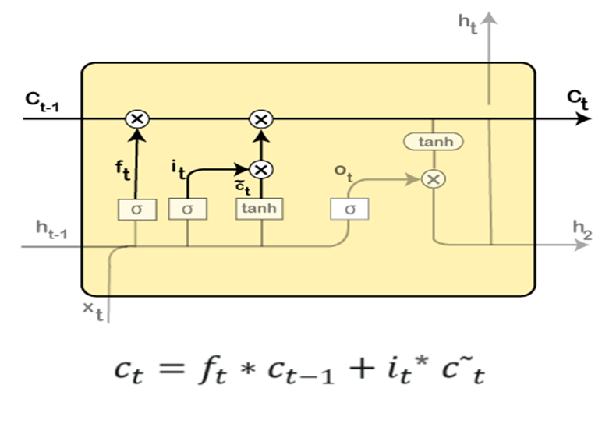
Step-by-step approach to understand LSTM
Step 3:
In the 3rd step, the previous cell state Ct-1 will get updated into the new cell state Ct.
And for that, we will need to multiply the old state (Ct-1) by f(t), keeping the things aside that we thought that we earlier decided to leave.
Next, add it* c˜t, which is the new candidate values. It has been actually scaled by how much we wanted to update each state value.
In the second step, it was decided to make use of the data, which is only required at that stage. However, in the third step, it is executed.

Slide 39
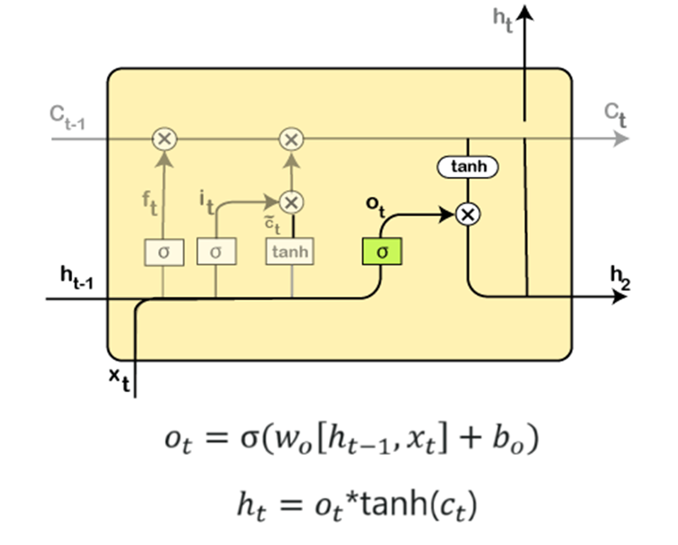
Step-by-step approach to understand LSTM
Step 4:
In the 4th step, run the sigmoid layer that will decide for those parts of the cell state that will result in the output.
Next, put the cell state through tanh, which means we will be pushing the values in between the range of -1 and 1.
And then, further, multiply it with the sigmoid gate's output so that only the decided parts results in the output.
In this step, some calculations will result in the output.
However, the output consists of only the outputs that were decided to be carry forwarded in the previous steps and not all the outputs at once.

Slide 40
Step-by-step approach to understand LSTM
A Quick Recap:
At first, find out what is to be dropped.
Then in the second step, it included newly added inputs to the network.
In the third step, the earlier obtained inputs get combined in order to produce the new cell states.
Lastly, arrive at the output as per requirement.

Slide 41
LSTM
Input gate determines the extent to which the current timestamp input should be used.
the Forget gate determines the extent to which output of the previous timestamp state should be used.
Output gate determines the output of the current timestamp.

Slide 42
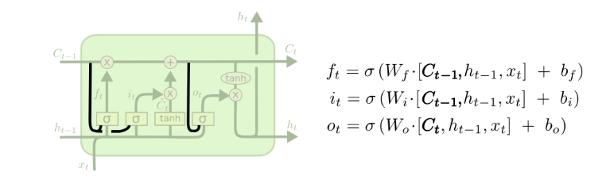
Variants of LSTM -1
It allows gate layers to look at the cell state. It adds peepholes to all the gates.
https://colah.github.io/posts/2015-08-Understanding-LSTMs/

Slide 43
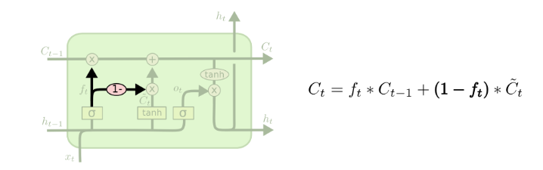
Variants of LSTM -2
Forget and input gates are coupled together.
Instead of separately deciding what to forget, it makes use of those decisions together.
It forgets while inputting something in its place, Input new values to the state when required to forget something older.

Slide 44
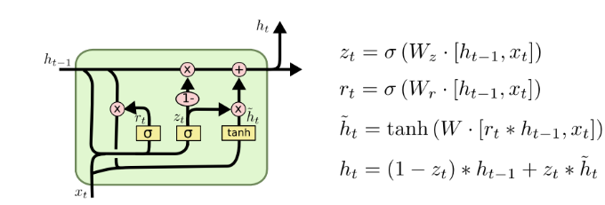
Variants of LSTM -3
Gated Recurrent Unit, or GRU: It combines the forget and input gates into a single “update gate.”
It also merges the cell state and hidden state, and makes some other changes.
The resulting model is simpler than standard LSTM models, and has been very popular.

Slide 45
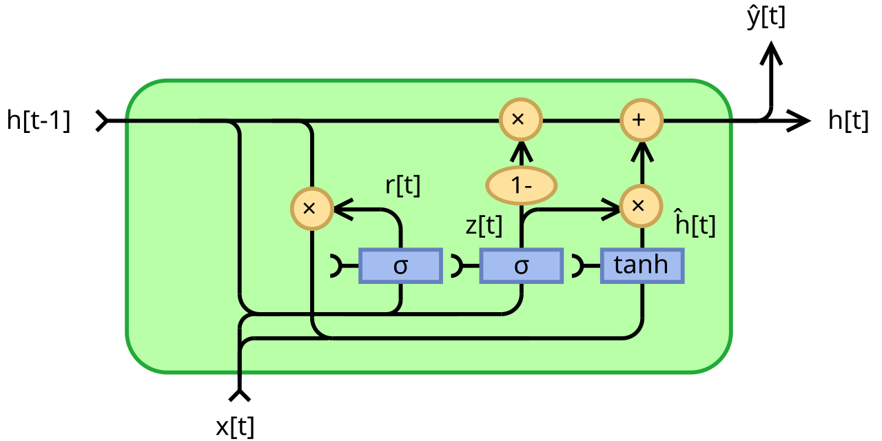

Fully Gated Unit

Slide 46
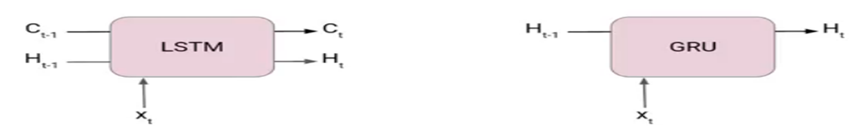
Gated Recurrent Unit
LSTMs are very complex structure with higher computational cost. To overcome this Gated Recurrent Unit (GRU) where introduced which uses LSTM architecture by merging its gating mechanisms offering a more efficient solution for many sequential tasks without sacrificing performance.
The core idea behind GRUs is to use gating mechanisms to selectively update the hidden state at each time step allowing them to remember important information while discarding irrelevant details.
GRUs aim to simplify the LSTM architecture by merging some of its components and focusing on just two main gates: the update gate and the reset gate.
unlike LSTM, it does not have a separate cell state (Ct). It only has a hidden state(Ht). Due to the simpler architecture, GRUs are faster to train.

Slide 47
RNN, LSTM and GRU
https://ravjot03.medium.com/gru-explained-the-simplified-rnn-solution-for-sequential-data-c706d0d149c5
RNN (Recurrent Neural Network) – 1980s
Introduced as a way to process sequential data with feedback loops.
Problem: Struggles with long-term dependencies due to the vanishing gradient problem.
LSTM (Long Short-Term Memory) – 1997
Invented by Sepp Hochreiter and Jürgen Schmidhuber.
Solves the vanishing gradient issue using memory cells and gates (input, forget, output).
Became the dominant RNN variant for sequence tasks like language modeling and translation.
GRU (Gated Recurrent Unit) – 2014
Introduced by Kyunghyun Cho et al. as a simpler and faster alternative to LSTM.
Uses fewer gates (reset and update) but often achieves similar performance.
Became popular for its balance of performance and computational efficiency.

Slide 48
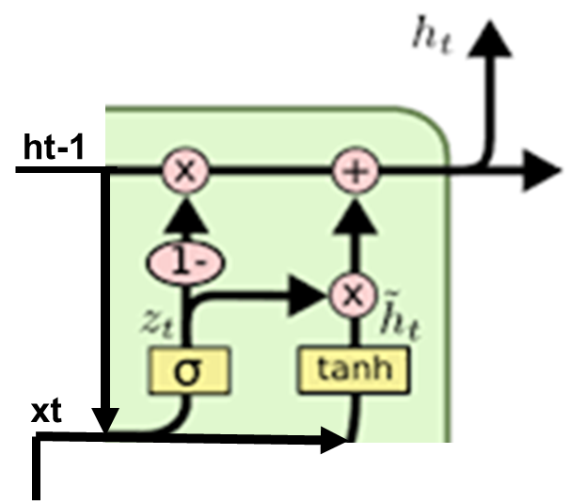
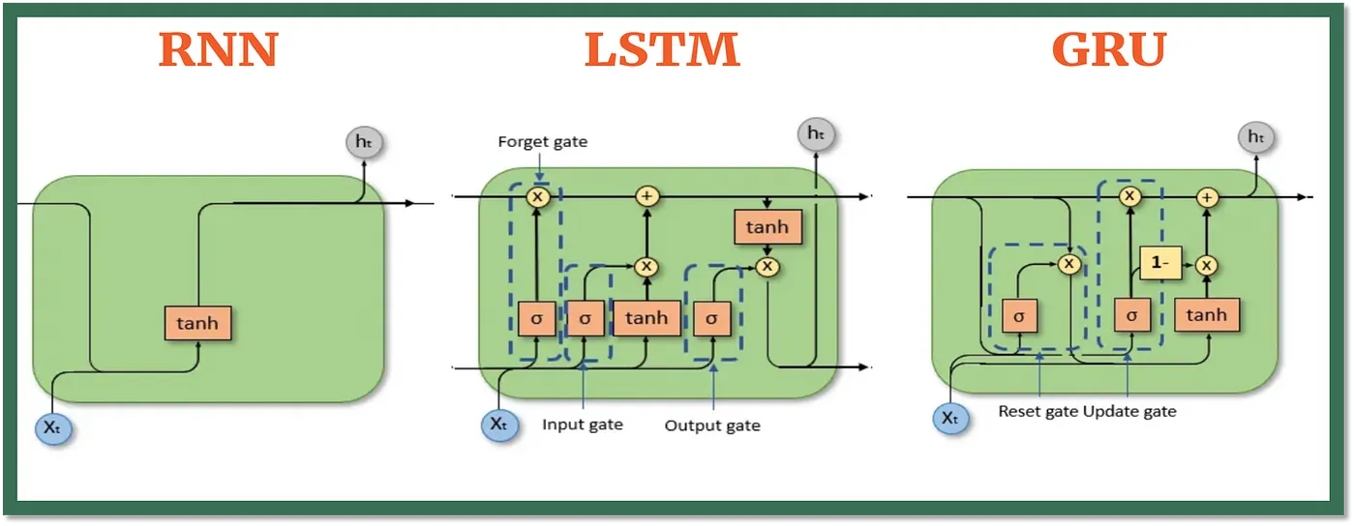
RNN, LSTM and GRU
Simple GRU
Zt = σ (Wz xt + Uz ht−1)
h~t = tanh ⁡(Wh xt + Uh ht−1)
ht = (1−zt) ht−1 + zt h~t​
Fully Gated

Slide 49
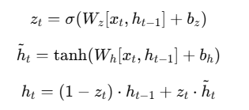
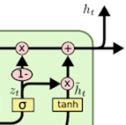
Simple GRU
.
In a Simple GRU, there is only one gate: the update gate (zₜ).
It decides how much of the previous hidden state (hₜ₋₁) to keep and how much of the new candidate state (h̃ₜ) to use.
ht-1
Simple GRU has only the update gate (zₜ).
This gate decides both:
.How much of the old hidden state ht−1 to keep
How much of the new candidate state h~t​ to add.
There is no separate mechanism to control resetting past information.
Disadvantage: If ht−1 has irrelevant or noisy information, Simple GRU cannot selectively ignore/reset it
xt

Slide 50
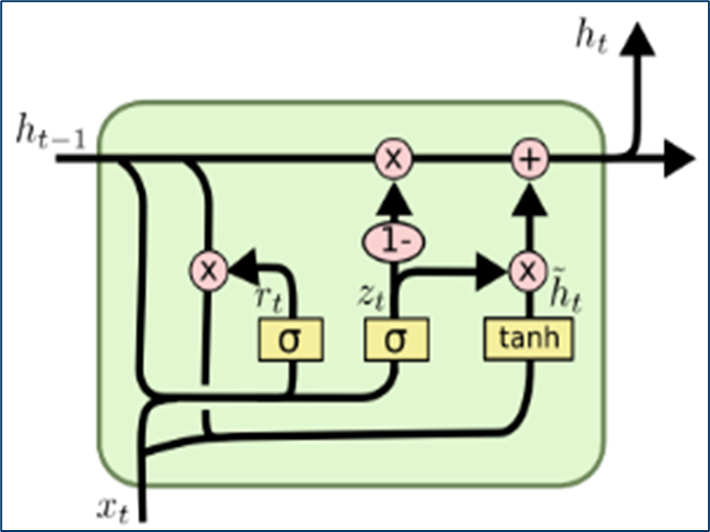
Fully Gated GRU
GRU is simpler in its design and requires fewer parameters to train, making it computationally efficient as compared to LSTM. GRU consists of two primary gates: Update Gate and the Reset Gate. These gates help the model decide what information to keep, update, and forget.
rt
A value of 0 means the model forgets everything from the previous hidden state, while a value of 1 means it keeps all the information.
The Reset Gate
The reset gate controls how much of the previous memory (hidden state) to forget. When processing a new input, the reset gate determines how much of the old hidden state should be discarded, allowing the model to reset its memory if needed.
Mathematical Formula:
rt = σ ( Wr ⋅ [ ht−1 , xt ] + br )
Where:
rt is the reset gate value at time step t.
Wr​ is the reset gate weight.
ht−1​ is the hidden state from the previous time step.
xt​ is the current input.
br is the bias term.
σ is the sigmoid activation function that outputs a value between 0 and 1.

Slide 51
Fully Gated GRU
The output of this gate is also between 0 and 1. A value of 0 means the model relies entirely on the previous hidden state, and a value of 1 means it relies entirely on the new input.
The Update Gate
The update gate decides how much of the new information should be passed to the current hidden state and how much of the previous state should be retained. This gate essentially controls how much memory from the past should be kept and how much should be updated with the new input.
Mathematical Formula:
zt = σ ( Wz ⋅ [ ht−1 , xt ] + bz )
Where:
zt​ is the update gate value at time step ttt.
Wz​ is the weight for the update gate.
ht−1 is the previous hidden state.
xt is the current input.
bz​ is the bias term.

Slide 52

Fully Gated GRU
The reset gate rt plays a key role in controlling how much of the previous hidden state should be involved when generating the candidate hidden state.
The candidate hidden state is the potential new memory that will be considered for updating the current hidden state. The model generates a candidate value based on the current input and the previous hidden state, but it only uses this new candidate when it is combined with the update gate.
Mathematical Formula:
h~t = tanh ⁡( Wh ⋅ [ rt ⋅ ht−1 , xt ] + bh )
Where:
h~t is the candidate hidden state.
Wh is the weight for the candidate hidden state.
rt is the reset gate value.
tanh⁡ is the hyperbolic tangent activation function, which helps scale the output between -1 and 1.

Slide 53
Fully Gated GRU
The result is a hidden state that incorporates the relevant parts of both the past and the present.
The Final Hidden State
Finally, the model combines the candidate hidden state with the previous hidden state, guided by the update gate. The final hidden state is a blend of the previous memory and the new candidate memory.
Mathematical Formula:
ht = ( 1 − zt ) ⋅ ht−1 + zt ⋅ h~t
Where:
ht​ is the final hidden state at time step t.
zt​ is the update gate value.
ht−1​ is the previous hidden state.
h~t​ is the candidate hidden state.

Slide 54
Fully Gated GRU Working
Steps in Working of GRU -
Calculate rt (Reset gate)
Calculate htbar (Candidate hidden state)
Calculate Zt (Update gate)
Calculate ht (Current hidden state)

Slide 55
Simple GRU Vs. Fully Gated GRU
Feature | Simple GRU | Fully Gated GRU
Gates | Only Update Gate (zt​) | Update Gate (zt​) + Reset Gate (rt​)
Equations | Zt = σ (Wz xt + Uz ht−1) h~t = tanh ⁡(Wh xt + Uh ht−1) ht = (1−zt) ht−1 + zt h~t​ | Zt = σ (Wz xt + Uz ht−1) Rt = σ (Wr xt + Ur ht−1) h~t = tanh ⁡(Wh xt + Uh (rt⊙ht−1)) ht = (1−zt) ht−1 + zt h~t
Control over past info | Limited (cannot reset old info) | Strong (reset gate allows ignoring irrelevant past info)
Complexity | Lower (fewer parameters) | Higher (extra gate and parameters)
Performance | Good for short dependencies | Better for long dependencies and noisy sequences
Vanishing Gradient Problem | Reduced (compared to vanilla RNN) | Further reduced
Use Cases | Small datasets, simple patterns | Complex sequences, NLP, speech recognition

Slide 56
LSTM Vs. Fully Gated GRU
Working of GRU given nicely
https://medium.com/@abhishekjainindore24/all-about-gru-gated-recurring-unit-d8990b2724cf
Feature | LSTM (Long Short-Term Memory) | GRU (Gated Recurrent Unit)
Inputs and Outputs | 3 Inputs and 2 Outputs | 2 Inputs and 1 Outputs
Gates | 3 (Input, Forget, Output) | 2 (Update, Reset)
States | Hidden state and Cell state | Hidden state
Parameters | More parameters | Less parameters
Training Speed | Slower due to complexity | Faster due to simpler architecture
Computational Load | Higher due to more gates and parameters | Lower due to fewer gates and parameters
Performance | Often better in tasks requiring long-term memory (Complex Tasks). | Performs similarly in many tasks with less complexity.

Slide 57
LSTM
https://www.javatpoint.com/keras-recurrent-neural-networks
https://medium.com/@humble_bee/rnn-recurrent-neural-networks-lstm-842ba7205bbf
https://colah.github.io/posts/2015-08-Understanding-LSTMs/
https://builtin.com/data-science/recurrent-neural-networks-and-lstm#:~:text=Simply%20put%3A%20Recurrent%20neural%20networks%20add%20the%20immediate%20past%20to,things%20other%20algorithms%20can’t.
https://www.geeksforgeeks.org/introduction-to-recurrent-neural-network/
https://www.analyticsvidhya.com/blog/2022/03/a-brief-overview-of-recurrent-neural-networks-rnn/
https://stanford.edu/~shervine/teaching/cs-230/cheatsheet-recurrent-neural-networks

Slide 58
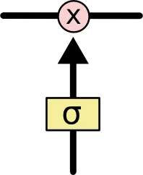
LSTM
Hidden state (hₜ ₋ ₁) and cell input (xₜ) data is used to control what to do with memory (cell state) cₜ : to forget or to write new information.
We decide what to do with memory knowing about previous cell output (hidden state) and current input and we do this using gates.
Gates are a way to optionally let information through. They are composed out of a sigmoid neural net layer and a point-wise multiplication operation.
LSTM Gate
The sigmoid layer outputs numbers between zero and one, describing how much of each component should be let through.
A value of zero means “let nothing through,” while a value of one means “let everything through!”
An LSTM has three of these gates, to protect and control the cell state.

Slide 59
Aspect | ANN | CNN | RNN
Type of Data | Tabular Data, Text Data | Image Data | Sequence data
Parameter Sharing | No | Yes | Yes
Fixed Length input | Yes | Yes | No
Recurrent Connections | No | No | Yes
Vanishing and Exploding Gradient | Yes | Yes | Yes
Spatial Relationship | No | Yes | No
Performance | ANN is considered to be less powerful than CNN, RNN. | CNN is considered to be more powerful than ANN, RNN. | RNN includes less feature compatibility when compared to CNN.
Application | Facial recognition and Computer vision. | Facial recognition, text digitization and Natural language processing. | Text-to-speech conversions.
Main advantages | Having fault tolerance, Ability to work with incomplete knowledge. | High accuracy in image recognition problems, Weight sharing. | Remembers each and every information, Time series prediction.
Disadvantages | Hardware dependence, Unexplained behavior of the network. | Large training data needed, don’t encode the position and orientation of object. | Gradient vanishing, exploding gradient.

Slide 60
Aspect | ANN | CNN | RNN
Structure and Components / Loop Mechanism | Consist of input, hidden, and output layers. Neurons in each layer connect to those in the next layer. | Composed of convolutional, pooling, and fully connected layers. Uses filters to detect spatial features in data. | Contains loops allowing information to pass from one step to the next, maintaining a ‘memory’ of previous inputs.
Working Mechanism | Processes inputs through layers. Each neuron applies a function to inputs, passing the result to the next layer. | Applies convolutional filters to input data, reducing dimensions with pooling layers, followed by classification. | Maintains hidden states to capture temporal dependencies, processes sequential data, and uses recurrent connections.
Advantages and Disadvantages | Advantages: Flexible, learns complex patterns. Disadvantages: Requires large data, can be slow to train, difficult to interpret. | Advantages: High accuracy in image tasks, automatic feature extraction. Disadvantages: Computationally intensive, requires significant GPU resources, struggles with spatially invariant data. | Advantages: Effective for sequential data, learns temporal dependencies. Disadvantages: Slow, complex training, prone to vanishing and exploding gradient issues.
Training and Performance | Requires large datasets, training can be slow. Performance varies based on complexity and size of the network | Training is computationally intensive, requires significant GPU resources. Excels in feature extraction from spatial data | Training can be complex and slow due to long-term dependency issues. Faces vanishing/exploding gradient problems

Slide 61
Aspect | ANN | CNN | RNN
Common Applications | Image classification, speech recognition, recommendation systems, financial forecasting. | Image and video recognition, medical image analysis, autonomous driving systems, object detection. | Time series prediction, natural language processing, speech recognition, machine translation, sentiment analysis.
Key Differences in Architecture | Consist of feedforward layers (input, hidden, output) | Composed of convolutional layers, pooling layers, and fully connected layers | Contains loops for feedback, allowing information to be passed from one step to the next, maintaining temporal dependencies
Data Types and Input Handling | Handles tabular data, text, and numerical data. Uses flattened input vectors | Primarily processes image and video data. Handles 2D grid-like structures | Specializes in sequential data like time series, text, and speech. Handles variable-length sequences
Training and Performance | Requires large datasets, training can be slow. Performance varies based on complexity and size of the network | Training is computationally intensive, requires significant GPU resources. Excels in feature extraction from spatial data | Training can be complex and slow due to long-term dependency issues. Faces vanishing/exploding gradient problems

Slide 62
https://www.softwebsolutions.com/resources/difference-between-cnn-rnn-ann.html
https://www.analyticsvidhya.com/blog/2024/05/ann-vs-cnn-vs-rnn/
https://www.naukri.com/code360/library/ann-vs-cnn-vs-rnn
https://www.softwebsolutions.com/resources/difference-between-cnn-rnn-ann.html

